Slide 1
I2C 통신 Signal 분석
2기 구자민

Slide 2
바이트 분석
1 바이트
2 바이트
4 바이트

Slide 3
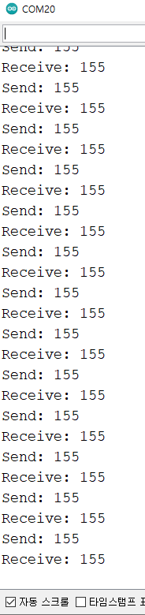
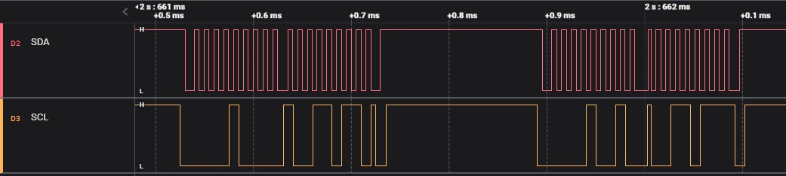
1바이트
0 0 0 0 1(4) 0 0
1(128) 0 0 1(16) 1(8) 0 1(2) 1(1)
0 0 0 0 1(4) 0 0
1(128) 0 0 1(16) 1(8) 0 1(2) 1(1)
Slave 주소 : 4
Write Data : 155
Slave 주소 : 4
Read Data : 155
0 0 0 0 1 0 0
1 0 0 1 1 0 1 1
0 0 0 0 1 0 0
1 0 0 1 1 0 1 1
Master -> Slave (Write)
Master <- Slave (Read)
Write bit(Master)
ACK bit(Slave)
Read bit(Master)
ACK bit(Slave)
NACK bit(Master)

Slide 4
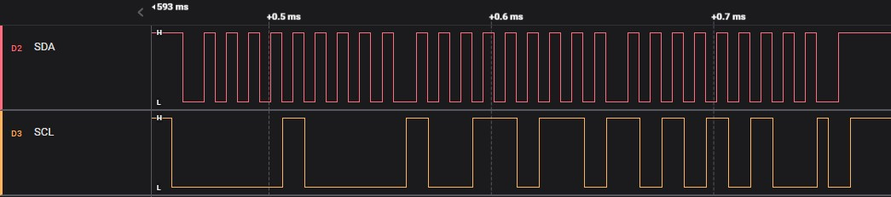
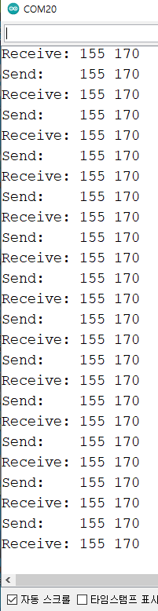
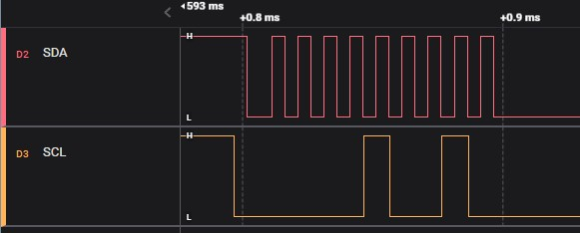
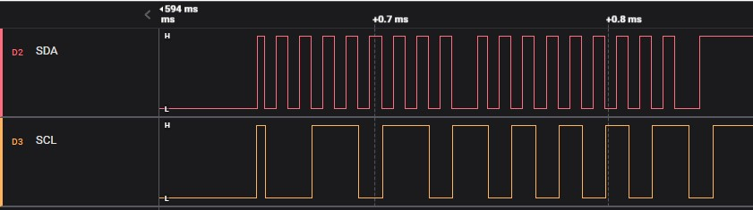
2바이트
1(128) 0 0 1(16) 1(8) 0 1(2) 1(1)
1(128) 0 1(32) 0 1(8) 0 1(2) 0
Write Data : 155, 170
0 0 0 0 1 0 0
1 0 0 1 1 0 1 1
1 0 1 0 1 0 1 0
Master -> Slave (Write)
Write bit(Master)
ACK bit(Slave)
1(128) 0 0 1(16) 1(8) 0 1(2) 1(1)
1(128) 0 1(32) 0 1(8) 0 1(2) 0
Read Data : 155, 170
0 0 0 0 1 0 0
1 0 0 1 1 0 1 1
1 0 1 0 1 0 1 0
Master <- Slave (Read)
Read bit(Master)
NACK bit(Slave)

Slide 5
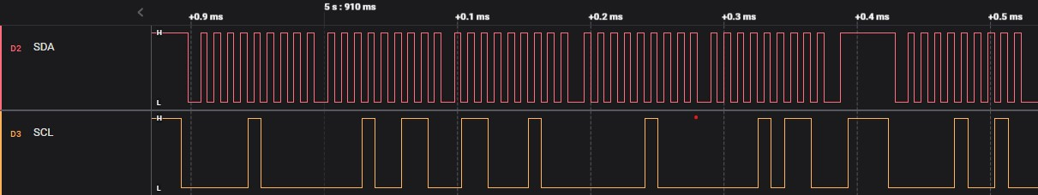
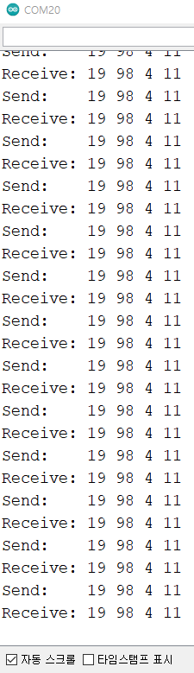
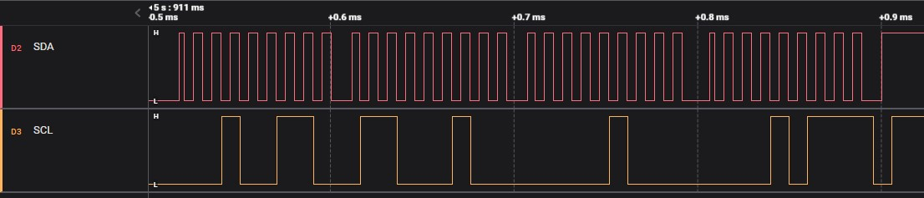
4바이트
0 0 0 0 1(4) 0 0
0 0 0 1(16) 0 0 1(2) 1(1)
0 1(64) 1(32) 0 0 0 1(2) 0
0 0 0 0 0 1(4) 0 0
0 0 0 0 1(8) 0 1(2) 1(1)
Slave 주소 : 4
Write Data : 19, 98, 4 ,11
0 0 0 0 1 0 0
0 0 0 1 0 0 1 1
0 1 1 0 0 0 1 0
0 0 0 0 0 1 0 0
0 0 0 0 1 0 1 1
Master -> Slave (Write)
Write bit(Master)
0 0 0 0 1(4) 0 0
ACK bit(Slave)
Slave 주소 : 4
0 0 0 0 1 0 0
0 0 0 1 0 0 1 1
0 1 1 0 0 0 1 0
0 0 0 0 0 1 0 0
0 0 0 0 1 0 1 1
Master <- Slave (Read)
0 0 0 1(16) 0 0 1(2) 1(1)
0 1(64) 1(32) 0 0 0 1(2) 0
0 0 0 0 0 1(4) 0 0
0 0 0 0 1(8) 0 1(2) 1(1)
Read bit(Master)
Write Data : 19, 98, 4 ,11
NACK bit(Slave)

